Slide 1


CMR Toolkit Threshold Model Module
Salma Bengali, Alan Morris, Josh Cates,
Rob MacLeod
CARMA Center/SCI Institute
University of Utah
© 2012, All Rights Reserved

Slide 2
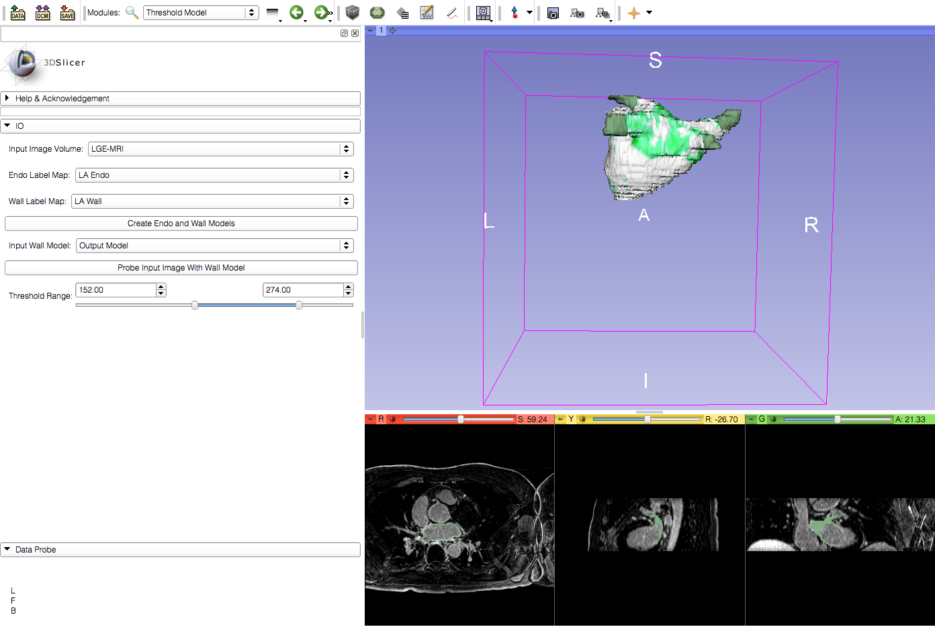
Learning Objective
Threshold Model Module in Slicer
© 2012, All Rights Reserved

Slide 3
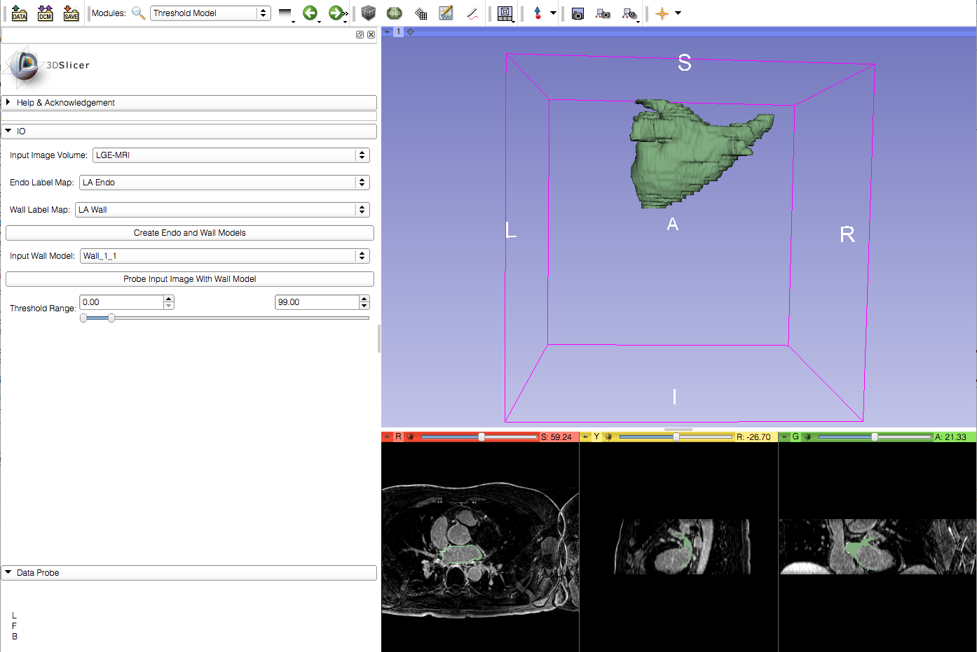
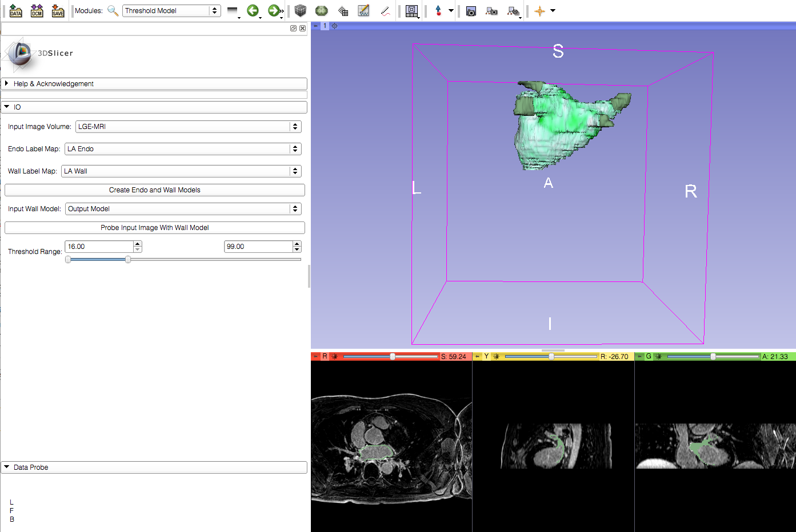
Current Workflow
Wall and Endo Models
MRI Projected on Wall Model
Thresholded Model

Slide 4
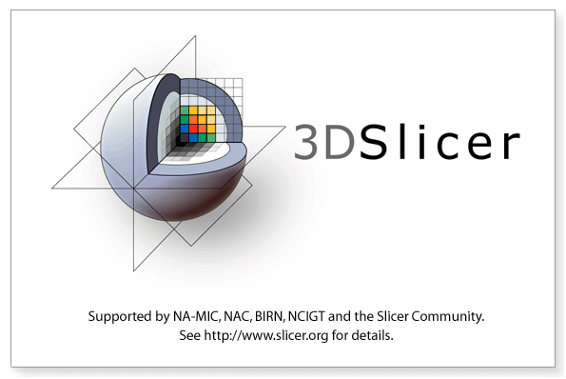
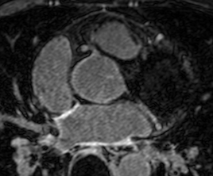
Required Materials
Slicer: Release 4.2
http://www.slicer.org/pages/Downloads/
Data: CARMA Slicer Extension Tutorial Data
http://hdl.handle.net/1926/1765
© 2012, All Rights Reserved

Slide 5

Additional Sample Data
60 patients
http://hdl.handle.net/1926/1757

Slide 6
Pre-requisite Tutorial
http://www.slicer.org/slicerWiki/index.php/Documentation/4.0/Training
© 2012, All Rights Reserved

Slide 7


Platforms
Developed
Tested
© 2012, All Rights Reserved

Slide 8
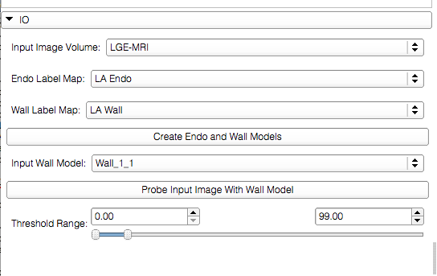
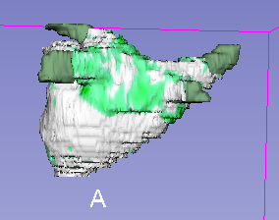
Overview
Load the data
Threshold the model
© 2012, All Rights Reserved

Slide 9
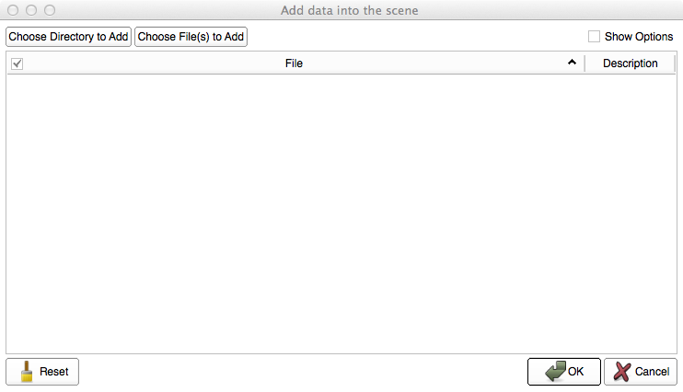
Loading the Data
Select ‘Choose Directory to Add’ in the pop-up menu

Slide 10
Loading the Data
Select the directory containing your dataset

Slide 11
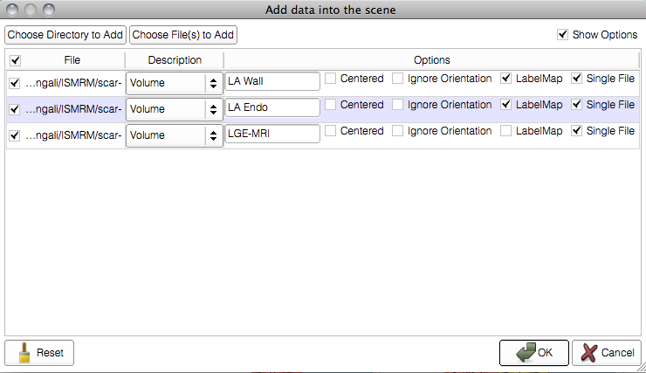
Loading the Data

Slide 12
Threshold Model
{
Input volumes
Output model

Slide 13
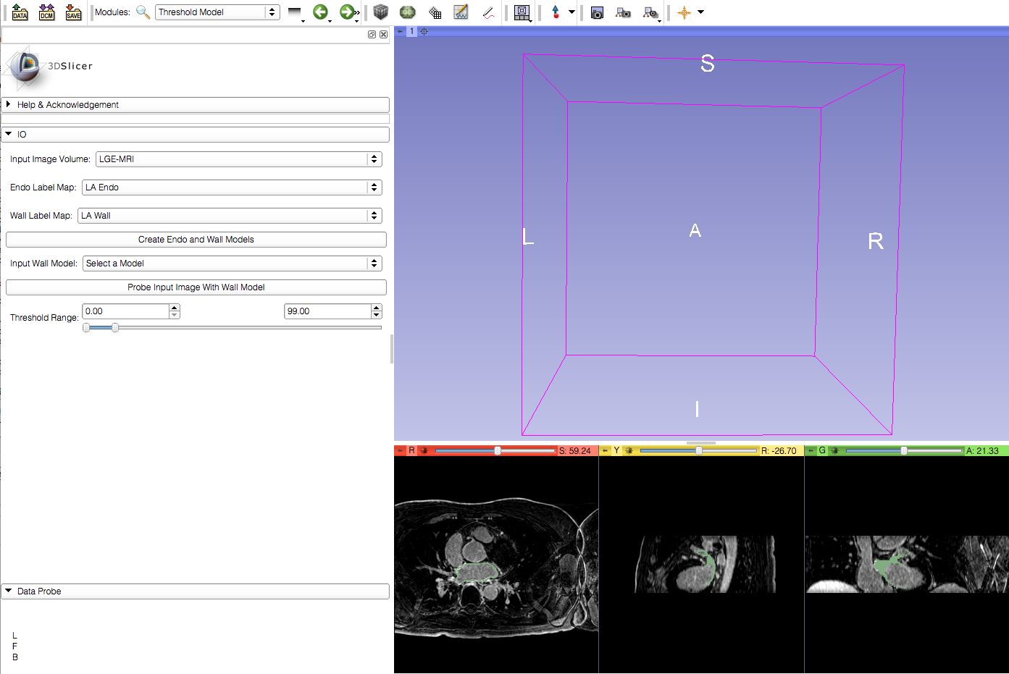
Threshold Model
Create the wall and endo models

Slide 14

Threshold Model
Viewer automatically updates to show the output models

Slide 15
Threshold Model
Select the wall model for the next step

Slide 16
Threshold Model
2.The MRI image intensity will be mapped to the wall model
1.Select the probe input image button

Slide 17
Threshold Model
Adjust the thresholds as required

Slide 18
Conclusion
This module can be used for thresholding a model of the left atrium wall.

