Slide 1


Connected Threshold Image Filter
Salma Bengali, Alan Morris,
Josh Cates, Rob MacLeod
SCI Institute/CARMA Center
University of Utah
© 2012, All Rights Reserved

Slide 2
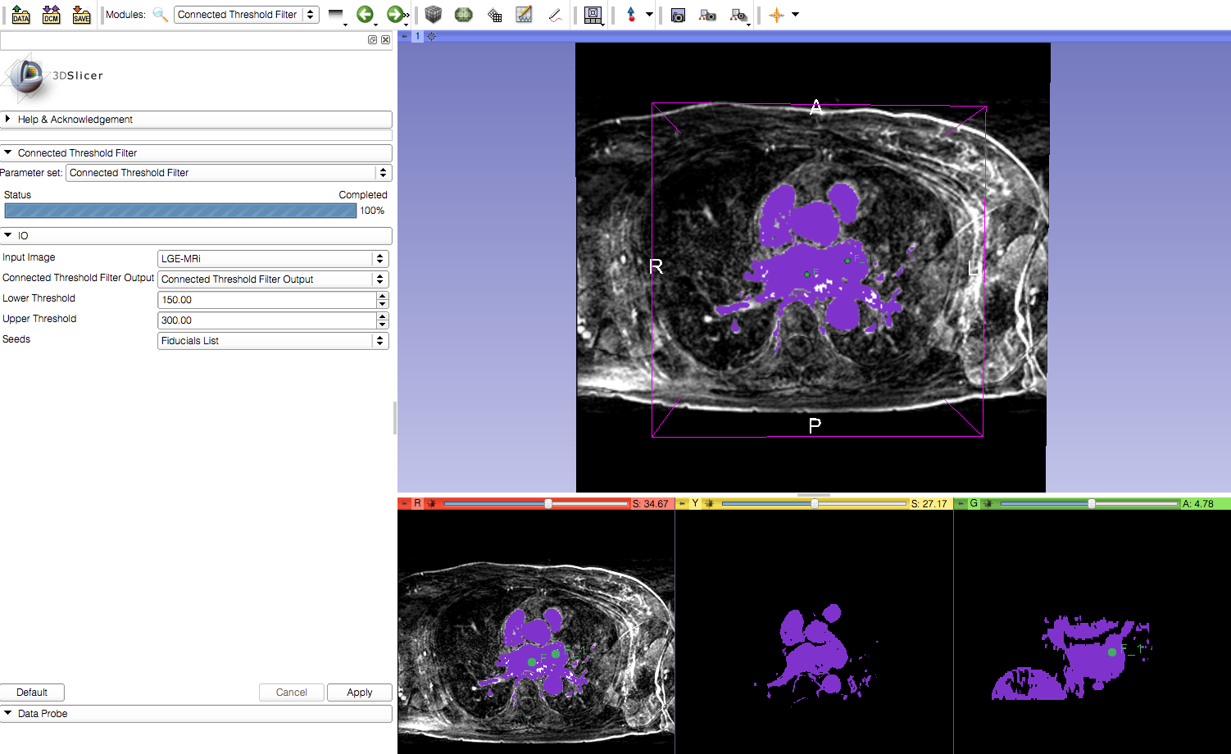
Learning Objective
Connected Threshold Image Filter in Slicer
© 2012, All Rights Reserved

Slide 3
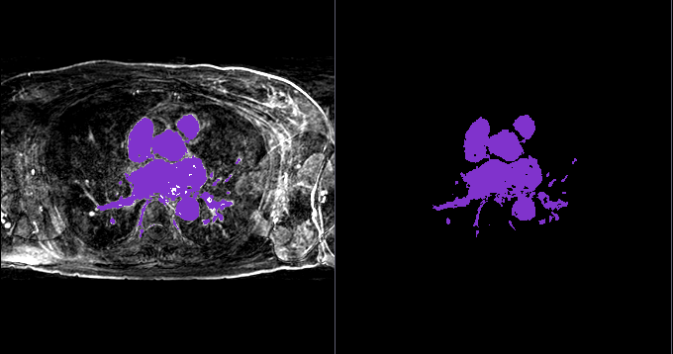
Current Workflow
Cardiac LGE-MRI Image
Segmented Image
© 2012, All Rights Reserved

Slide 4
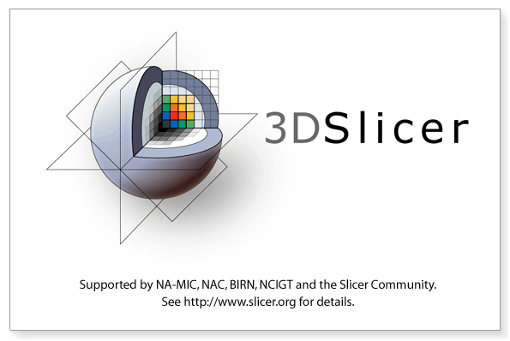
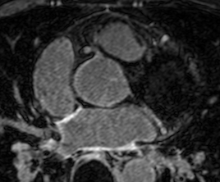
Required Materials
Slicer: Release 4.1
http://www.slicer.org/pages/Downloads/
Data: CARMA Slicer Extension Tutorial Data
http://hdl.handle.net/1926/1765
© 2012, All Rights Reserved

Slide 5

Additional Sample Data
60 patients
http://hdl.handle.net/1926/1757
© 2012, All Rights Reserved

Slide 6
Pre-Requisite Tutorial
http://www.slicer.org/slicerWiki/index.php/Documentation/4.0/Training
© 2012, All Rights Reserved

Slide 7


Platforms
Developed
Tested
© 2012, All Rights Reserved

Slide 8
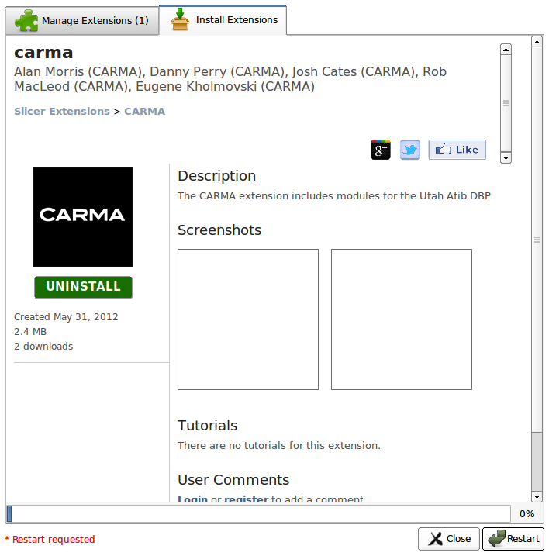
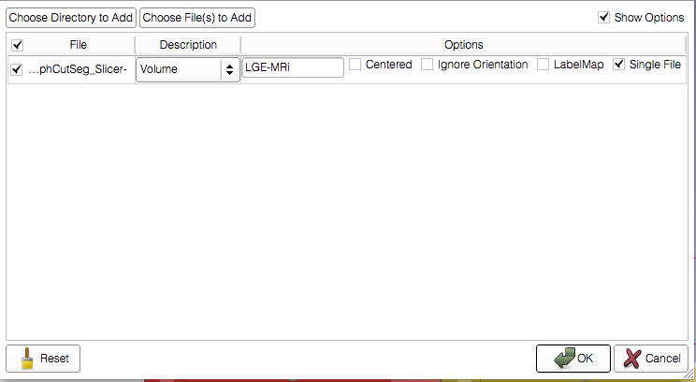
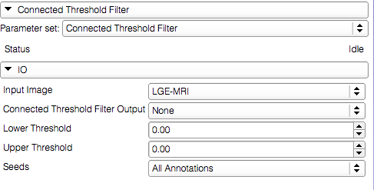
Overview
Load the module
Load the dataset
Connected Threshold Filter
© 2012, All Rights Reserved

Slide 9
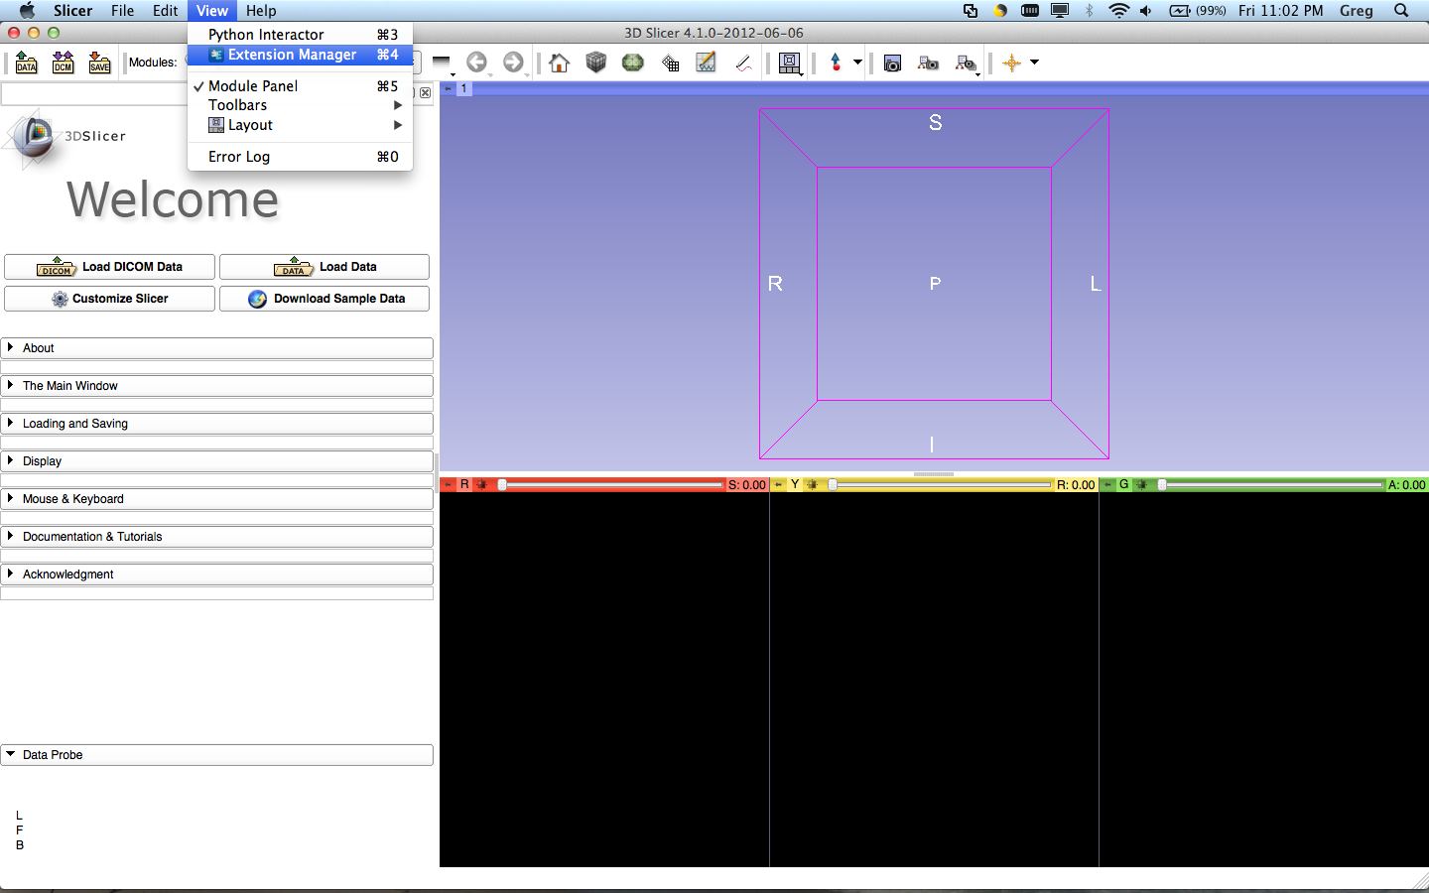
Loading the Module
Select View>Extension Manager in the menu bar (or push ⌘4)
If the Extension Manager isn’t revealed, see the next 2 slides; otherwise, skip them
© 2012, All Rights Reserved

Slide 10
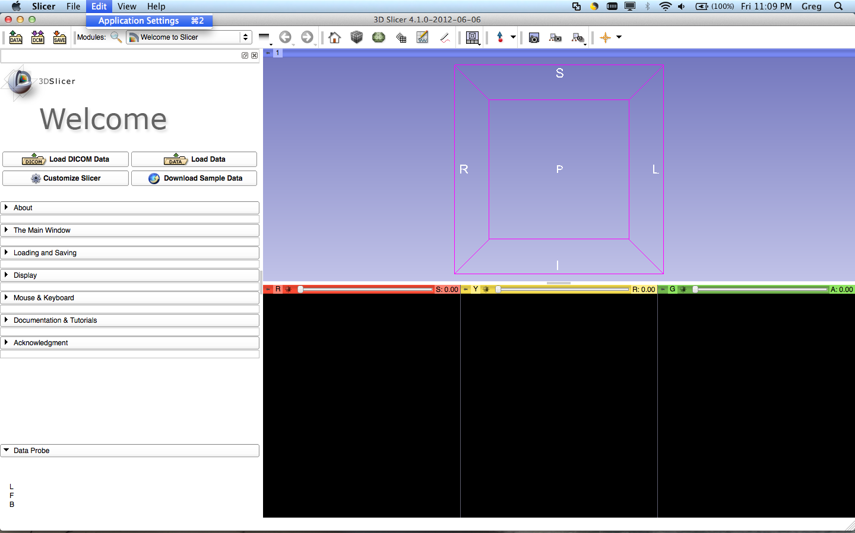
Loading the Module
To load the Extension Manager, Select Edit>Application Settings in the menu bar (or push ⌘2)
© 2012, All Rights Reserved

Slide 11
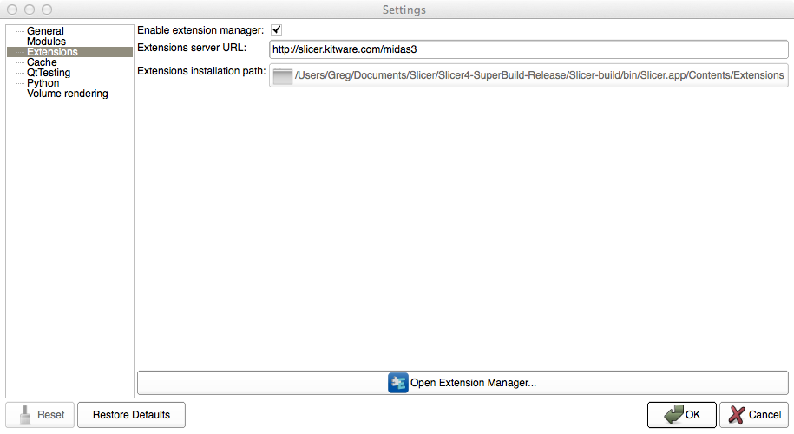
Loading the Module
Under the Extension menu, make sure ‘Enable extension manager’ is checked
© 2012, All Rights Reserved

Slide 12
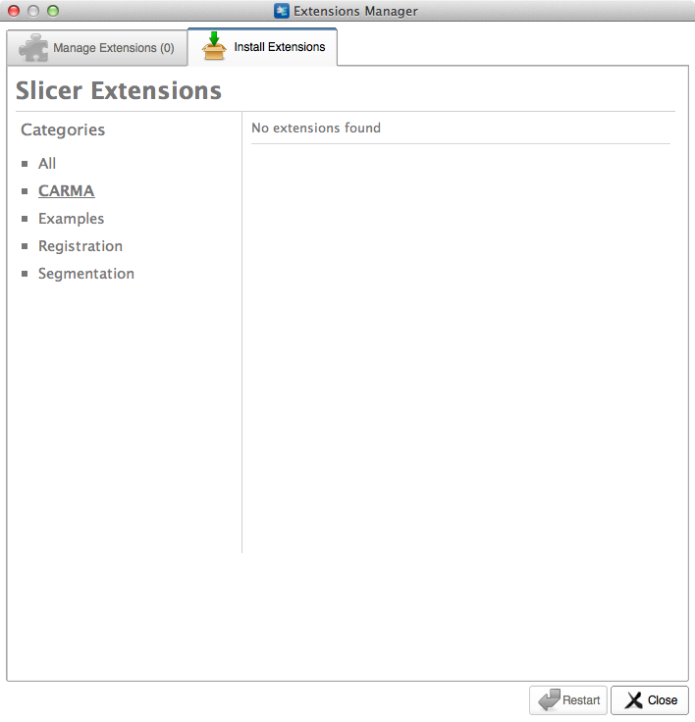
Loading the Module
Select CARMA in the sidebar and click the extensions
© 2012, All Rights Reserved

Slide 13
Loading the Module
Restart to install the extension
© 2012, All Rights Reserved

Slide 14
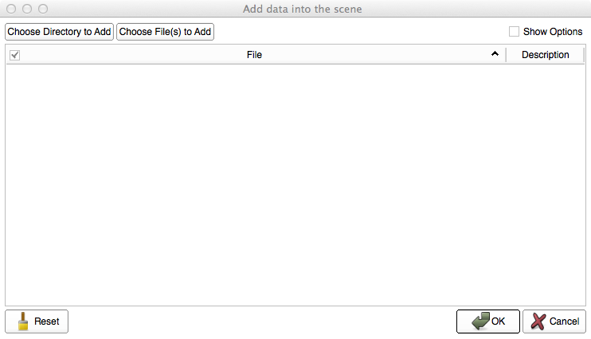
Loading the Data
Select ‘Choose Directory to Add’ in the pop-up menu
© 2012, All Rights Reserved

Slide 15
Loading the Data
Select the directory containing your dataset
© 2012, All Rights Reserved

Slide 16
Loading the Data

Slide 17
Image Segmentation
Input volume
Output volume
Fiducials
© 2012, All Rights Reserved

Slide 18
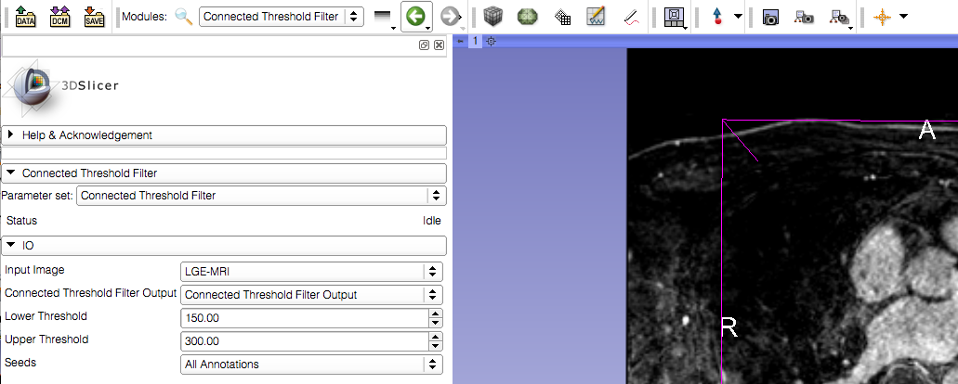
Image Segmentation
2. Select the Annotations menu option
1. Set the lower and upper thresholds depending on the intensity of the region being segmented
© 2012, All Rights Reserved

Slide 19
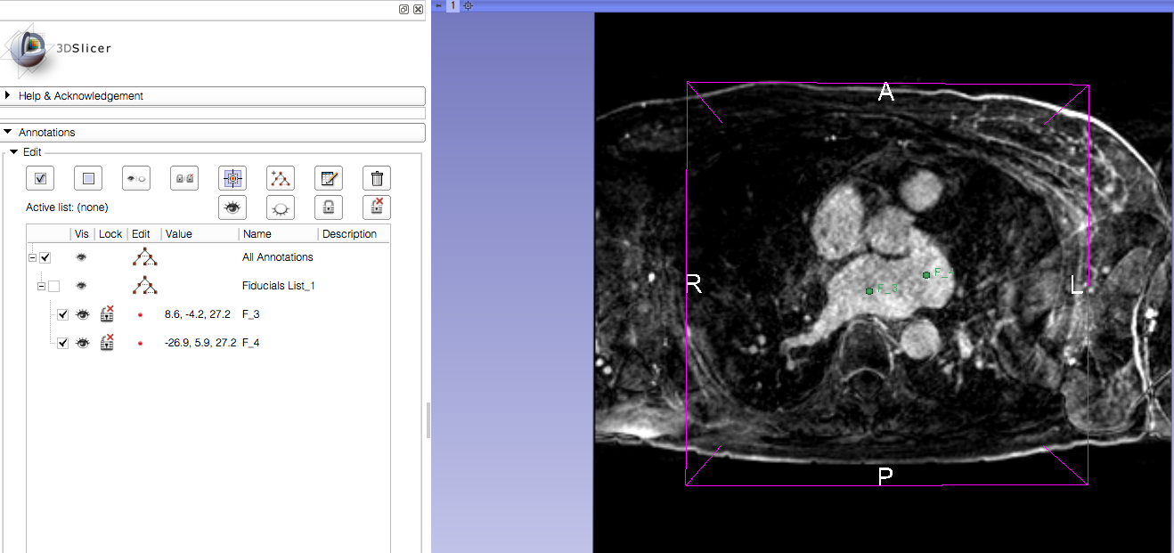
Image Segmentation
Create a set of fiducials inside the region to be segmented.
© 2012, All Rights Reserved

Slide 20
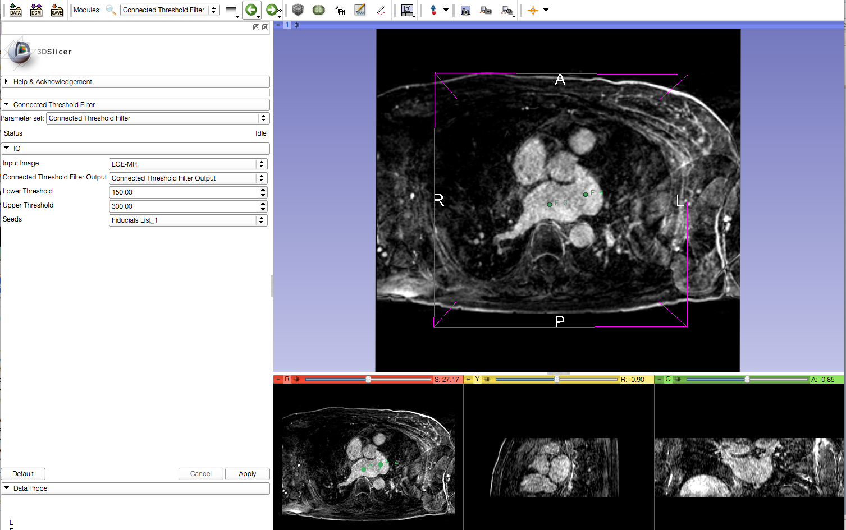
Image Segmentation
Apply the segmentation
© 2012, All Rights Reserved

Slide 21
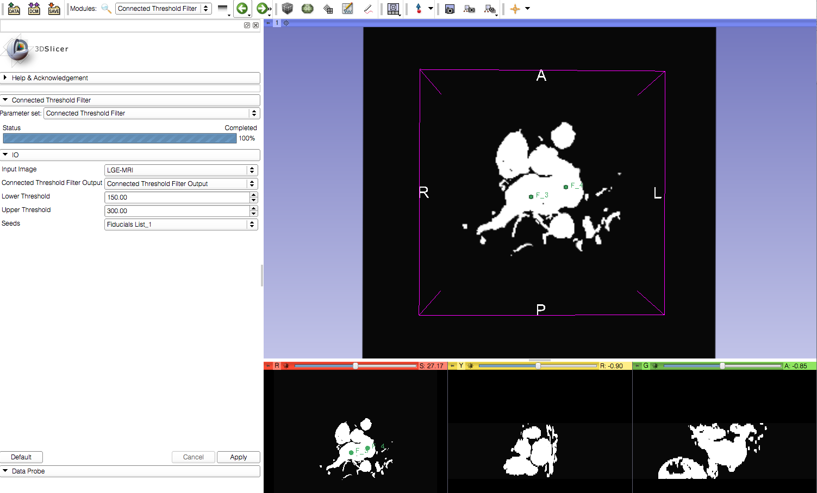
Image Segmentation
Viewer automatically updates to show the resulting output
© 2012, All Rights Reserved

Slide 22
Conclusion
This module can be used to segment the endocardium region from an LGE-MRI or MRA scan.
© 2012, All Rights Reserved

