Slide 1
Tumor Segmentation from DCE-MRI with OpenCAD
3D Slicer Training
Vivek Narayan, Jayender Jagadeesan
Brigham and Women’s Hospital
Harvard Medical School
jayender@bwh.harvard.edu
April 24, 2014

Slide 2
Objective of this Module
Segment regions of angiogenesis corresponding to the tumor from DCE-MRI
DCE-MRI should have a minimum of two post-contrast + one pre-contrast images
Typically, for breast tumor segmentation we use DCE-MRI with 4 post-contrast + pre-contrast images
Segmentation of the tumor is based on black-box method of estimating the slope of wash-in and wash-out of contrast

Slide 3
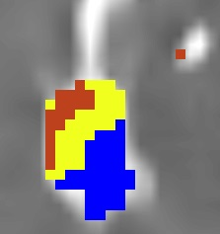
Segmentation Algorithm
Voxels (V_{e}) with initial enhancement > 75% are highlighted
Slope of delayed curve S_{d} = (I₄-I₁)/I₁
For V_{e} voxels, overlay label map with following colors:
Red for washout curve
(S_{d} < -0.2 | Type III)
Yellow for plateau curve
(-0.2 < S_{d} < 0.2 | Type II)
Blue for persistent curve
(S_{d} > 0.2 | Type I)

Slide 4
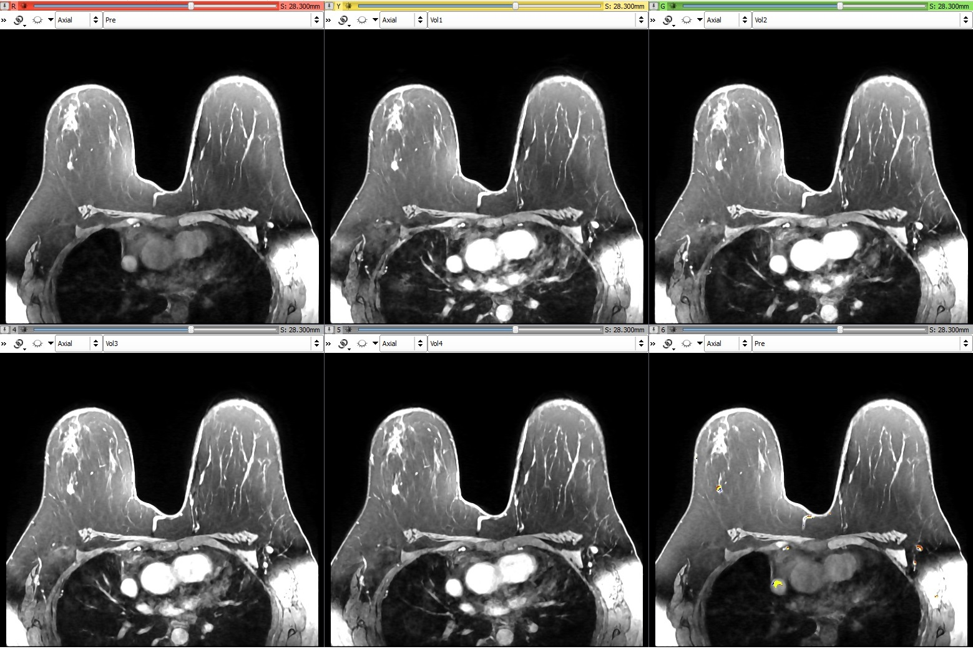
Example case
Pre-contrast
First post-contrast
Second post-contrast
Third post-contrast
Fourth post-contrast
Tumor map overlaid
on Pre-contrast

Slide 5
Slicer module
This tutorial will guide you through the process of loading DCE-MRI and segmenting the regions of angiogenesis (corresponding to tumor) using the “OpenCAD” module in 3D Slicer.

Slide 6
Prerequisites
-64-bit platform
-Download “Breast DCE-MRI Dataset 1” under Data Sets from the Wiki: http://www.slicer.org/slicerWiki/index.php/Documentation/4.3/Extensions/OpenCAD
Optional
-BRAINSfit registration of DCE-MRI images
-Image noise filters (Median Image Filter and Curvature Anisotropic Diffusion modules in 3DSlicer)

Slide 7
Part 1: Download the OpenCAD Extension from the Slicer Extension Manager in the “Segmentation” category.

Slide 8
Part 2: Loading the example data

Slide 9
Start Slicer

Slide 10
Load DCE-MRI data
Click on “Load Data”

Slide 11
Choose Directory
Click on “Choose Directory to Add”
Point to the directory containing
the DCE-MRI volumes
Click on “Choose”

Slide 12
Volumes Loaded in Slicer

Slide 13
Part 3: Create a Label Map mask
Reason: To speed up computation. Only the voxels within the mask (ROI) are analyzed

Slide 14
Editor Module
Choose the “Editor” module
Click Apply

Slide 15
Mask Using Threshold
Set Master Volume to Pre
Name of label is automatically
set to Pre-label
Click on the button for
“ThresholdEffect”

Slide 16
Mask Using Threshold
Set to 539.00
Set to 18.50
Click on “Apply”

Slide 17
Part 4: Segment tumor from DCE-MRI using the OpenCAD module

Slide 18
Switch to OpenCAD module
Choose “Segmentation”
Under “Segmentation” choose
“OpenCAD”

Slide 19
Selecting Input Volumes
Choose “Pre”
Choose “Vol1”
Choose “Vol2”
Choose “Vol3”
Choose “Vol4”
Choose “Pre-label”
Enable this checkbox

Slide 20
Set Output Parameters
Click on “Create new Volume”
Automatically set to “OpenCAD Label Map”
Keep all other parameters at the default settings
Click on “Apply OpenCAD Segmentation”

Slide 21
The OpenCAD Label Map will be generated within 30 seconds

Slide 22
Post-Segmentation
Layout switches to “Conventional Quantitative”
Red Slice displays “OpenCAD Label Map” overlaid on pre-contrast image
3D viewer displays Volume Rendering of “OpenCAD Label Map”
Quantitative viewer graphs %-increase from pre-contrast of voxel under mouse cursor throughout all input Volumes.

Slide 23
Display Tumor Label Map
Tumor in Volume Rendering of Label Map
Voxel at mouse location
(Pre: 0.0, Vol1: 1.0, …)
“OpenCAD Label Map” overlaid on images

Slide 24
Find Tumor in Label Map
Visible Tumor
Scroll through Axial View

Slide 25
Refine the Label Map
Enable “Calculate OpenCAD Label statistics”
Change the Minimum Threshold to 100.00%
Click on “Apply OpenCAD”

Slide 26
Label Statistics
New “OpenCAD Label Map” generated
Label Map statistics displayed in the GUI

Slide 27
Label Statistics
Care should be taken while interpreting the label statistics since voxels within the heart which also show contrast enhancement over time are detected by the algorithm

