Slide 1
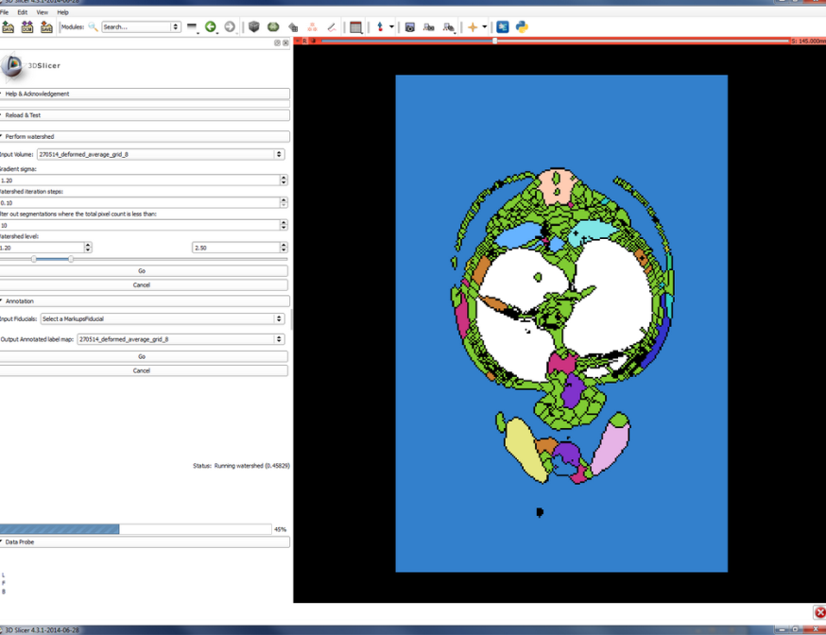
Segmentation training
Watershed Annotation and Segmentation Plugin (WASP) tutorial
- Thomas Lawson

Slide 2
Overview
Features/Workflow
Installing
Instructions
Demo (video)

Slide 3
Features
Perform a series of watershed segmentations
Uses SimpleITK “Morphological Watershed” without seeds
The user then selects the components out of the different watershed segmentation results
A label map is then created from the selection

Slide 4
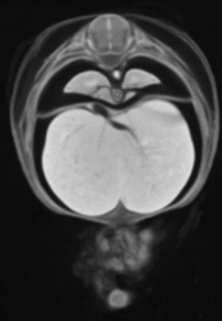
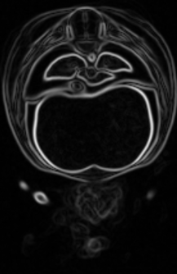
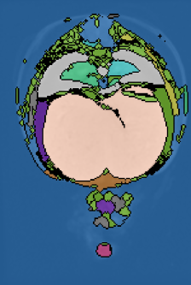
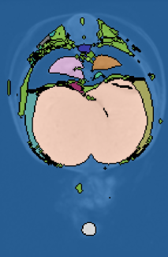
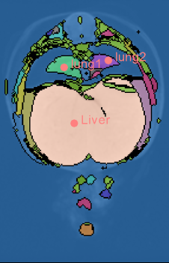
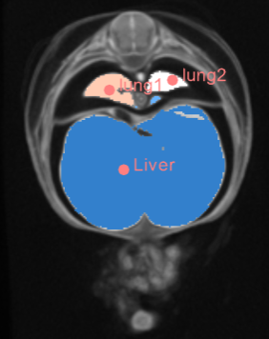
Work flow
Original image
Create gradient image
Perform multiple watershed segmentations based on user defined range
Place fiducials on components to be extracted
Produce a new label map

Slide 5
Installing 3D Slicer
Need the nightly version of 3D slicer
http://download.slicer.org/
Then download the latest version of WASP from https://github.com/Tomnl/Slicer-Wasp
NOTE: Check if the module is in the standard Slicer extensions first.

Slide 6
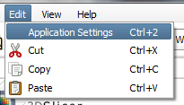
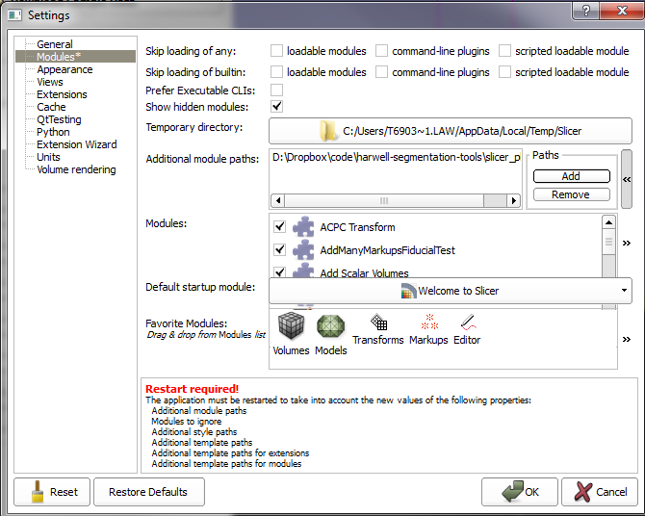
Installing a module
Open 3D Slicer
Edit->application settings
Modules->Additional module paths->Add->OK
Restart 3D Slicer
Plugin located in
“harwell-segmentation-tool” repo

Slide 7
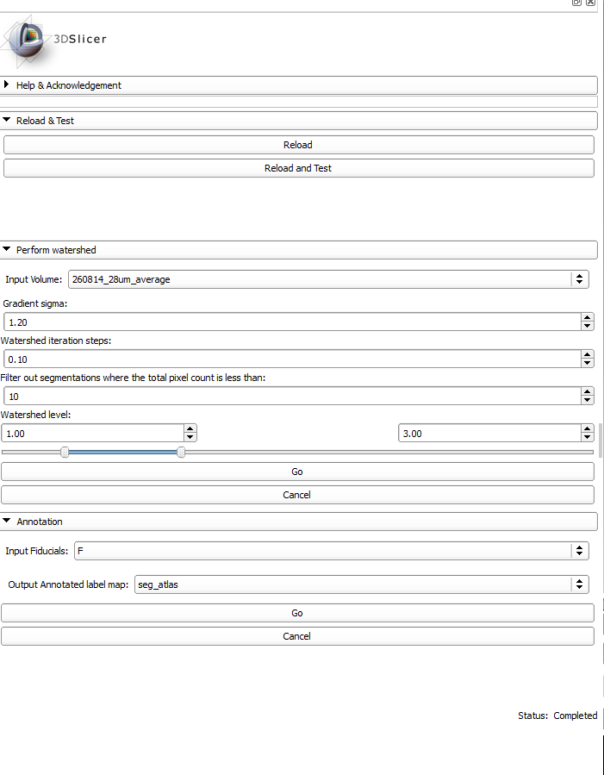
Setup for watershed
Input volume
Sigma used for Gaussian gradient magnitude filter
Number of watershed segmentations to be performed
Filter out segmentations/components where below a certain voxel count
Set the range of watershed levels

Slide 8
Running the watershed
Status bar updates
Watershed segmentations saved as label maps in 3D Slicer

Slide 9
Layout
Important: The following layout of image layers is required
Original image
Watershed label map

Slide 10
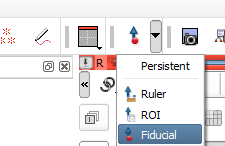
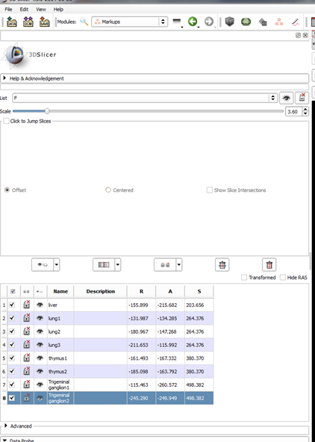
Annotation (adding fiducials)
Use fiducials to identify components to be extracted
Keep track of the fiducials in the markup module

Slide 11
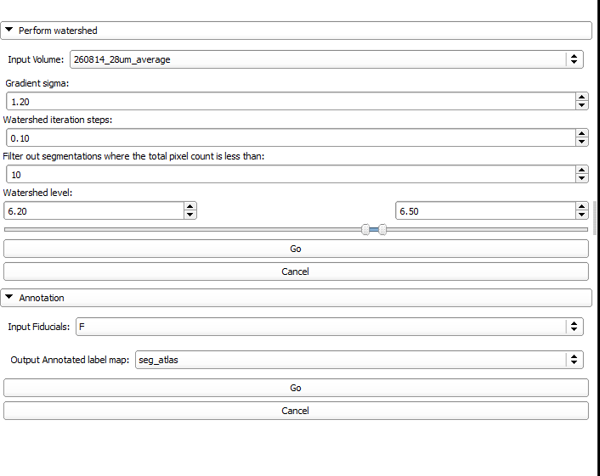
Annotation (Creating label map)
Choose a set of fiducials
Choose a name of the label map

Slide 13
Cleaning
Segmentation may require cleaning up
Can be done in Slicer, ITK-SNAP or ImageJ.
ITK-SNAP is my preferred method
Load in original image
Load in the label map as a segmentation
Use label map as seeds for a segmentation
Use volumteric paint brush
(Show example if using ITK-SNAP for Liver and ganglions)
See the SIG ITK-SNAP tutorial for more details
Notes:
13

Slide 14
Acknowledgements
SIG Team:
Henrik Westerberg
Neil Horner
James Brown

