Slide 1
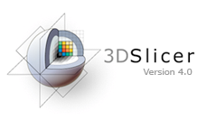
Slicer4Minute Tutorial
Sonia Pujol, Ph.D.
Surgical Planning Laboratory
Harvard Medical School

Slide 2
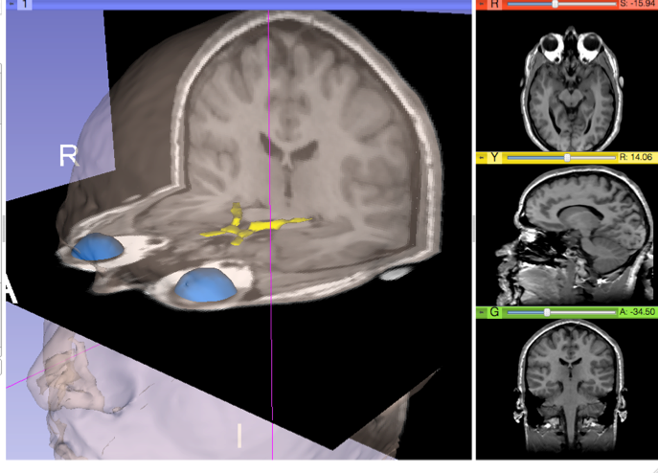
Slicer4 minute tutorial
This tutorial is a 4-minute introduction to the 3D visualization capabilities of the Slicer4 software for medical image analysis.

Slide 3
Slicer4 software
The Slicer4 software is available for download:
http://download.slicer.org

Slide 4
Slicer4 minute dataset
Download the slicer4minute-data.zip training dataset
http://wiki.slicer.org/slicerWiki/index.php/Training/4.0#Slicer4Minute_Tutorial

Slide 5
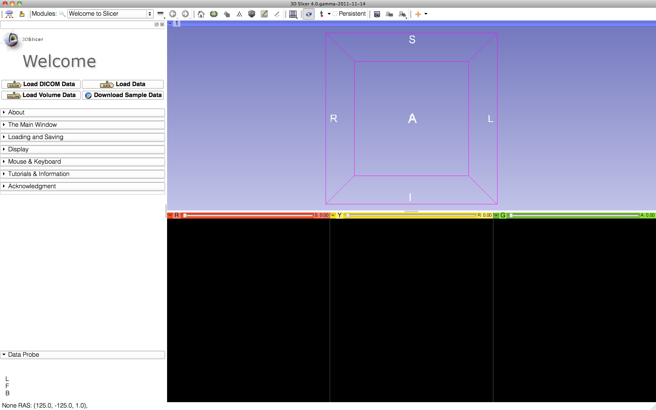
3DSlicer version 4.0
Start Slicer on your computer: the Welcome module is the default start-up module.

Slide 6
3D Slicer Scene
A Slicer scene is a MRML file which, contains the list of elements loaded into Slicer (volumes, models, fiducials…)
The following example uses a 3D Scene, which contains images and 3D surface models of the head.

Slide 7
3DSlicer version 4.0
Select File→ Load Scene from the main menu, and load slicer4minute.mrml

Slide 8
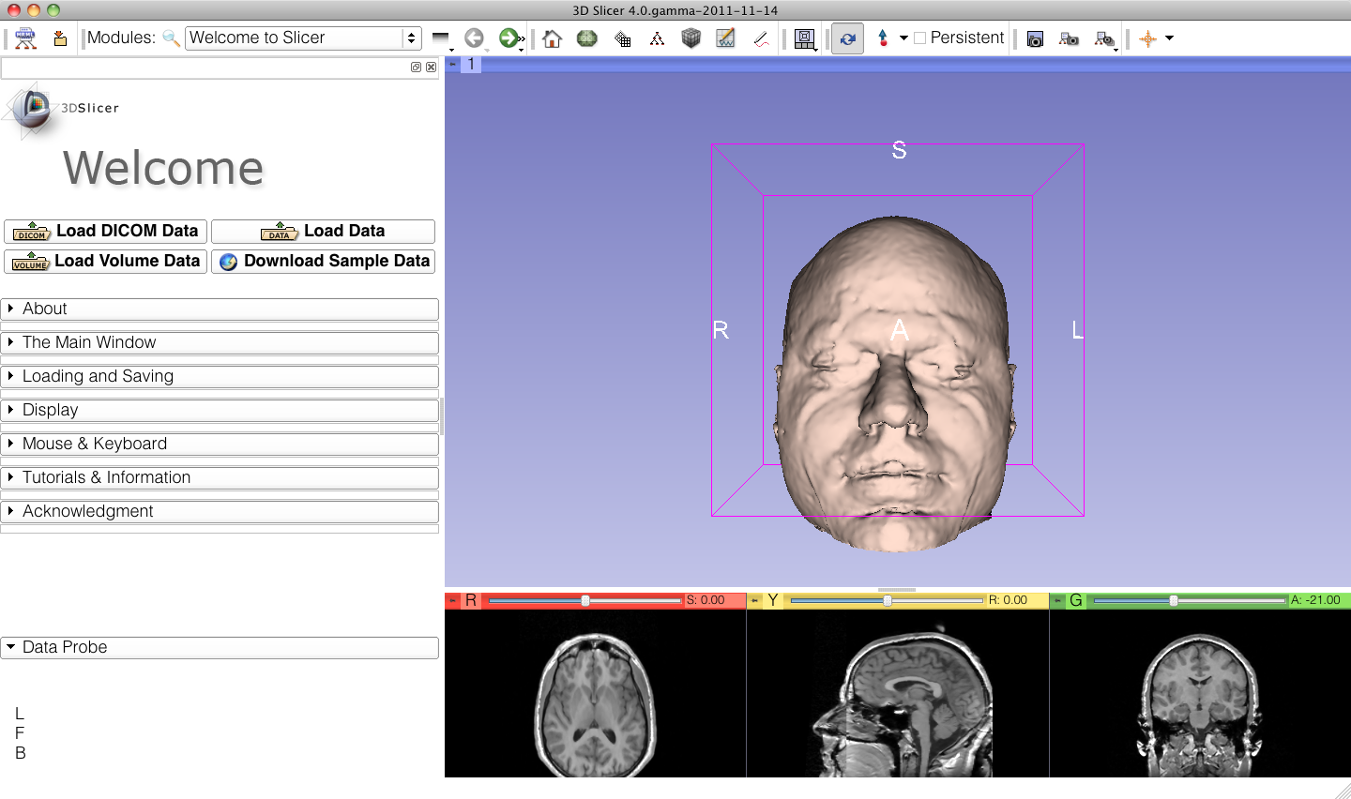
Slicer4 minute Scene
Slicer displays the elements of the slicer4minute scene, which contains the MR volume of the brain and a series of 3D surface models.

Slide 9
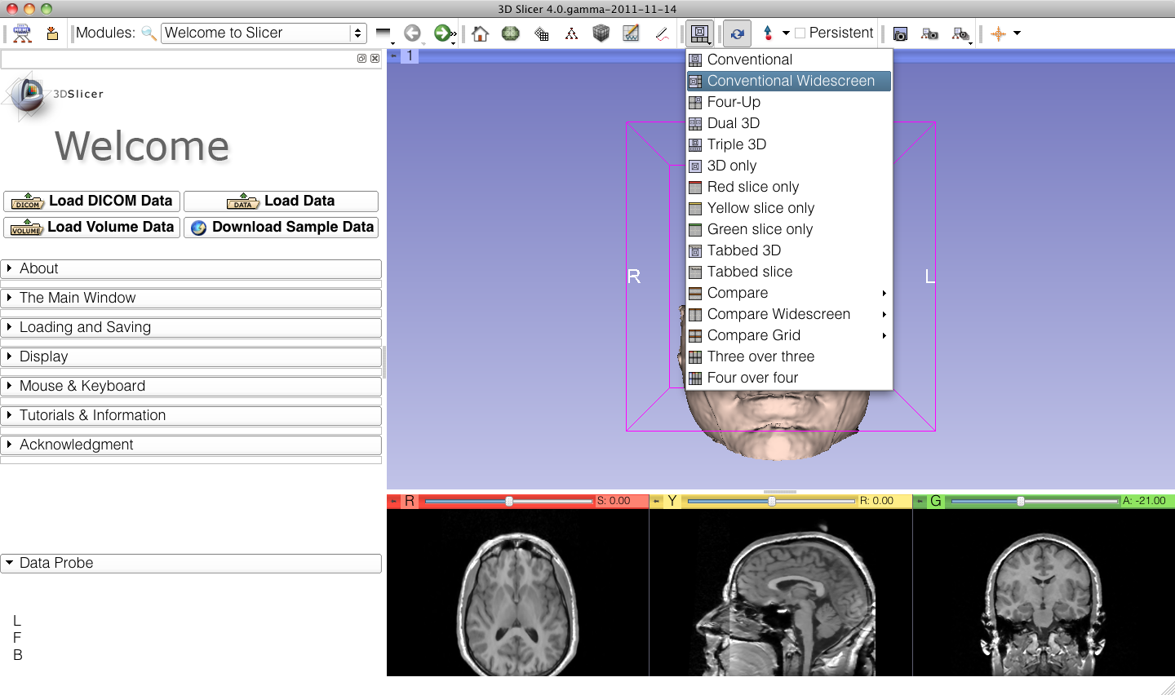
Slice4 minute scene
Select Conventional Widescreen from the viewing mode menu

Slide 10
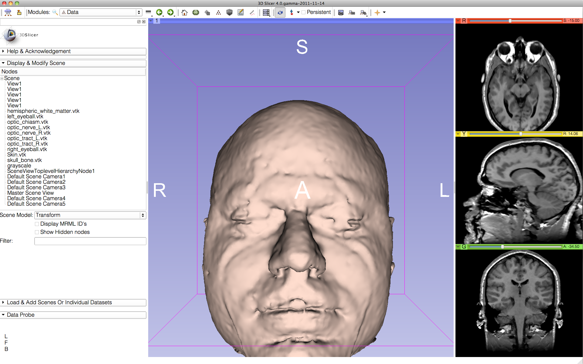
Slicer4minute Scene
Select Models from the Modules menu

Slide 11
3D Visualization
The Models module GUI displays the list of models loaded in the slicer4minute scene, their color and the value of their opacity (between 0.0 an 1.0)

Slide 12
3D Visualization
Click on the pin icon on the top left corner of the red slice to display the slice viewer menu then click on the eye icon to display the axial slice in the 3D Viewer

Slide 13
3D Visualization
Use the slider of the red viewer to browse through the axial MR slices.
Slicer simultaneously displays the slices in the 3D viewer.

Slide 14
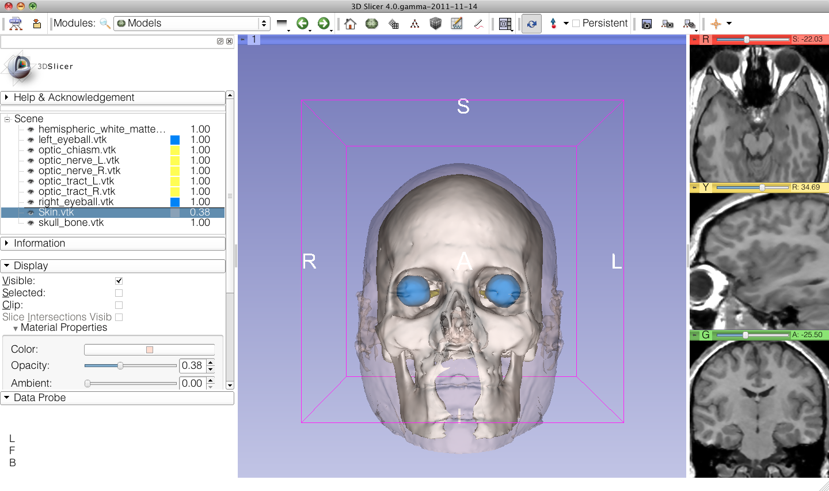
3D Visualization
Lower the opacity of the Skin.vtk model in the Display tab
The skull_bone.vtk model appears through the skin.

Slide 15
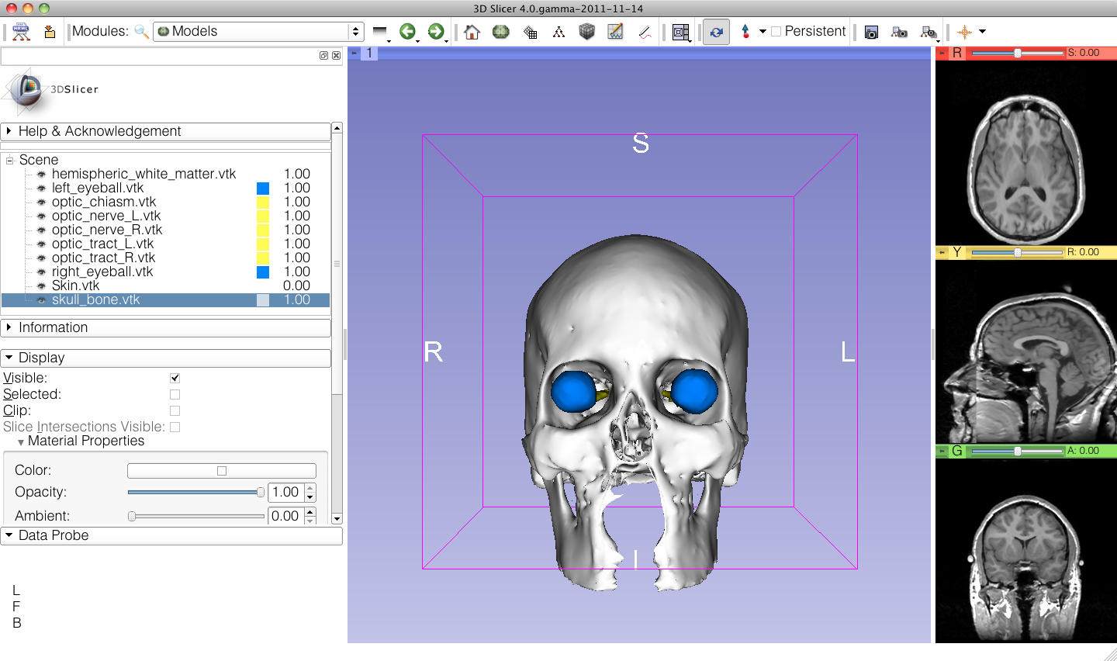
3D Visualization
Position the mouse in the 3D viewer.
Click the left-mouse button to drag and rotate the model.
Click the right-mouse button to zoom in and out.

Slide 16
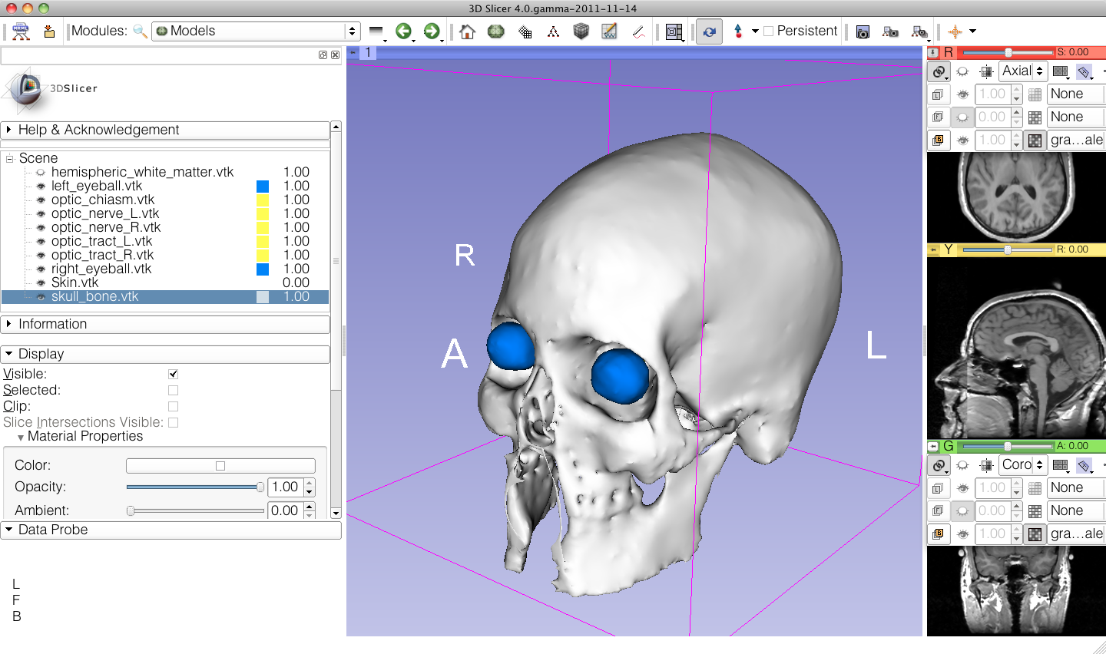
Anatomical Views
Click on the pin icons in the top left corners of the red and green viewers to display the viewers’ menu, and click on the eye icon to display the axial and coronal slice in the 3D viewer.

Slide 17
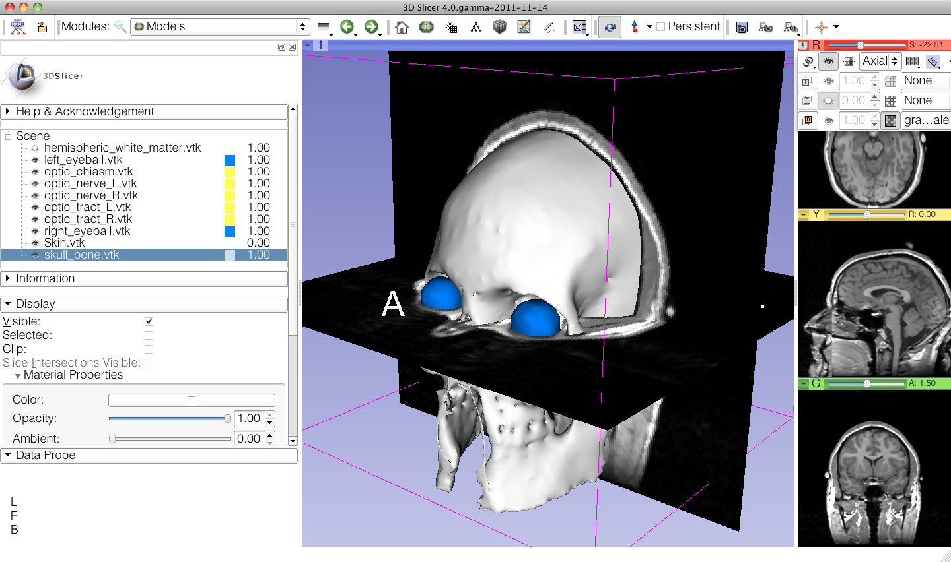
3D Visualization
Turn off the visibility of the skull bone to display the hemispheric white matter model

Slide 18
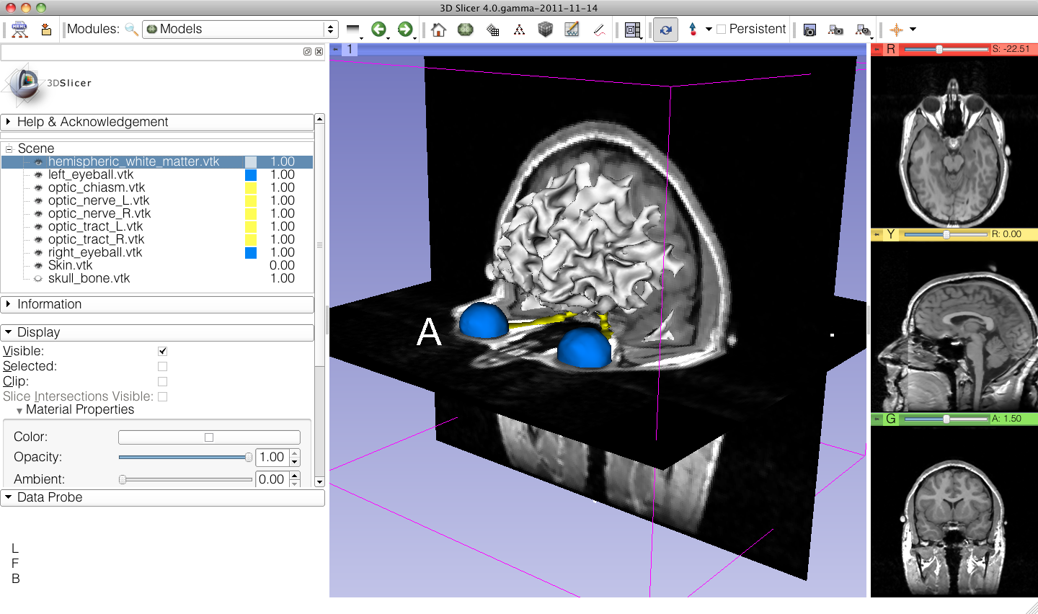
3D Visualization
The white matter surface, as well as the left and right optic nerves appear in the viewer

Slide 19
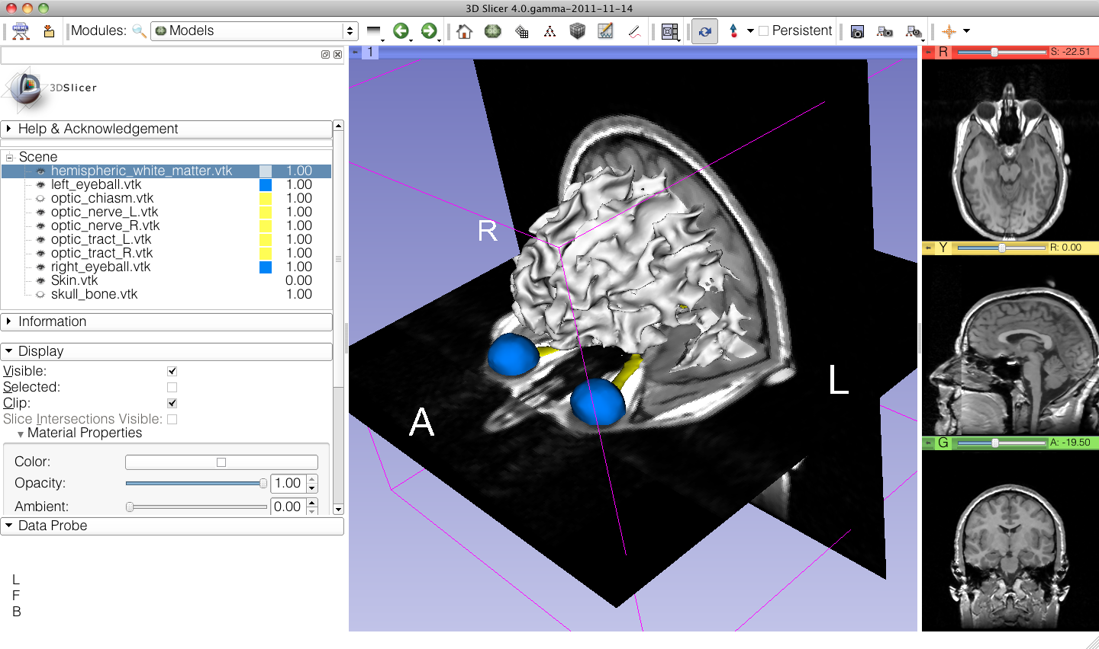
3D Visualization
Select the hemispheric_white_ matter.vtk model, and check Clip in the Display tab.

Slide 20
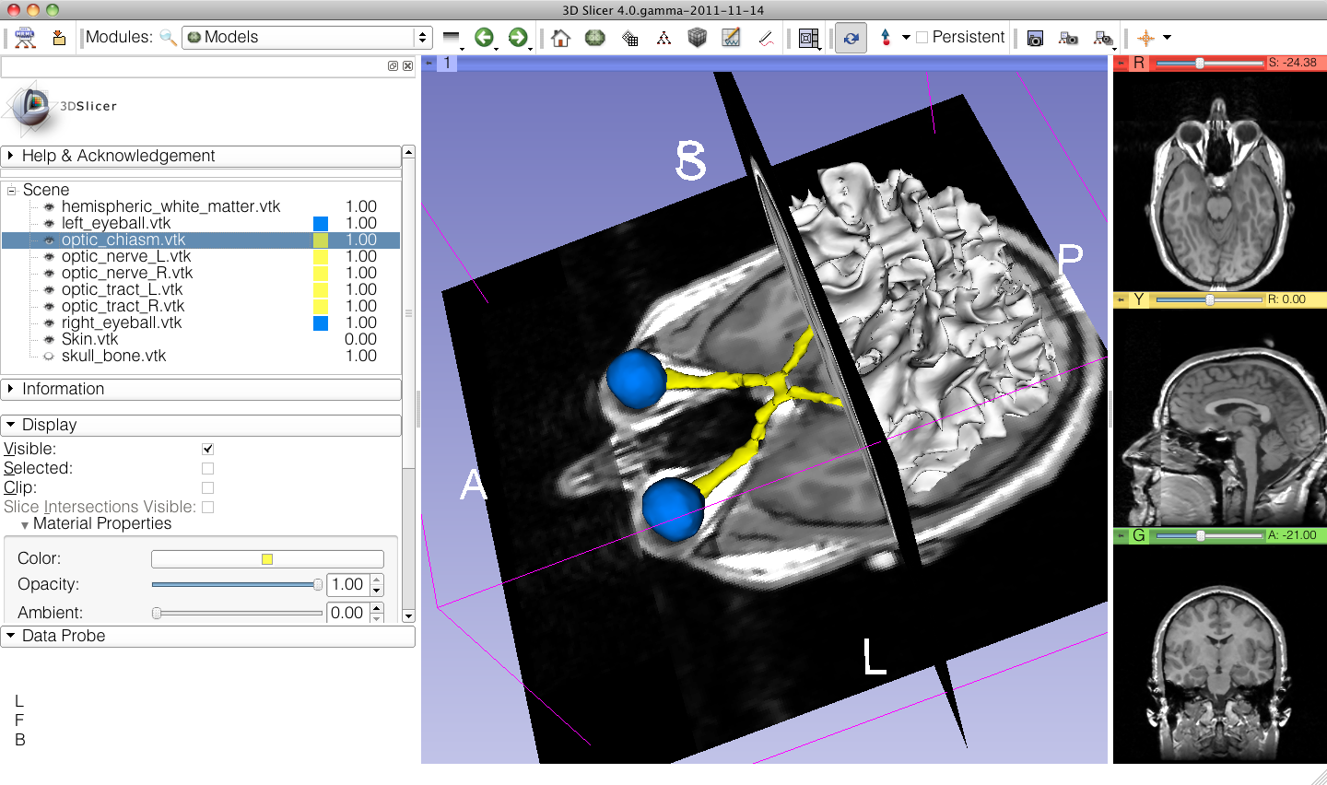
3D Visualization
Use the slider of the coronal view (green) to expose the optic chiasm.

Slide 21
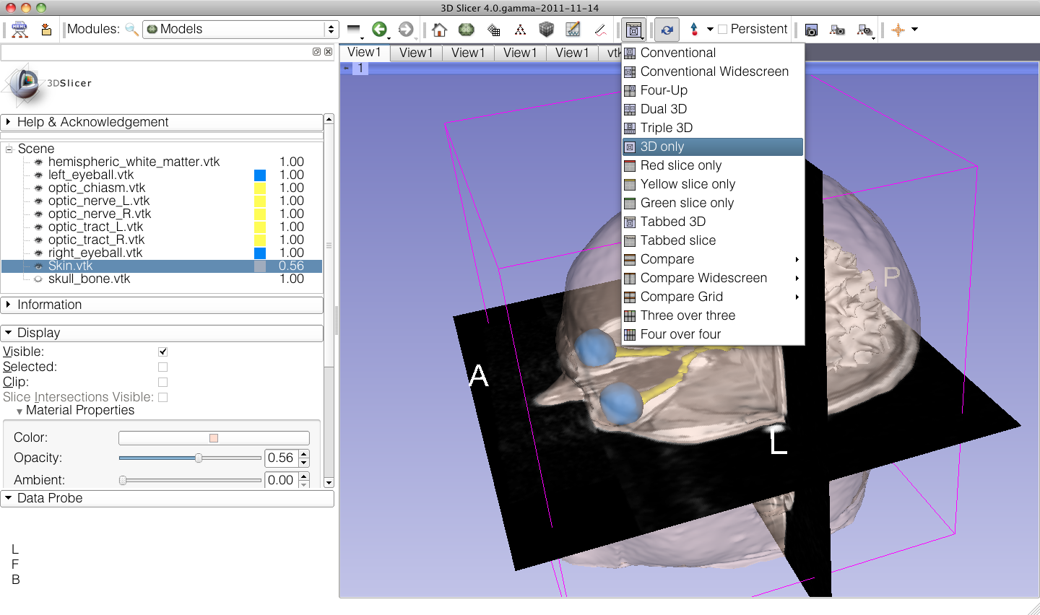
3D Visualization
Increase the opacity of
the skin model, and
select the viewing mode 3D only

Slide 22
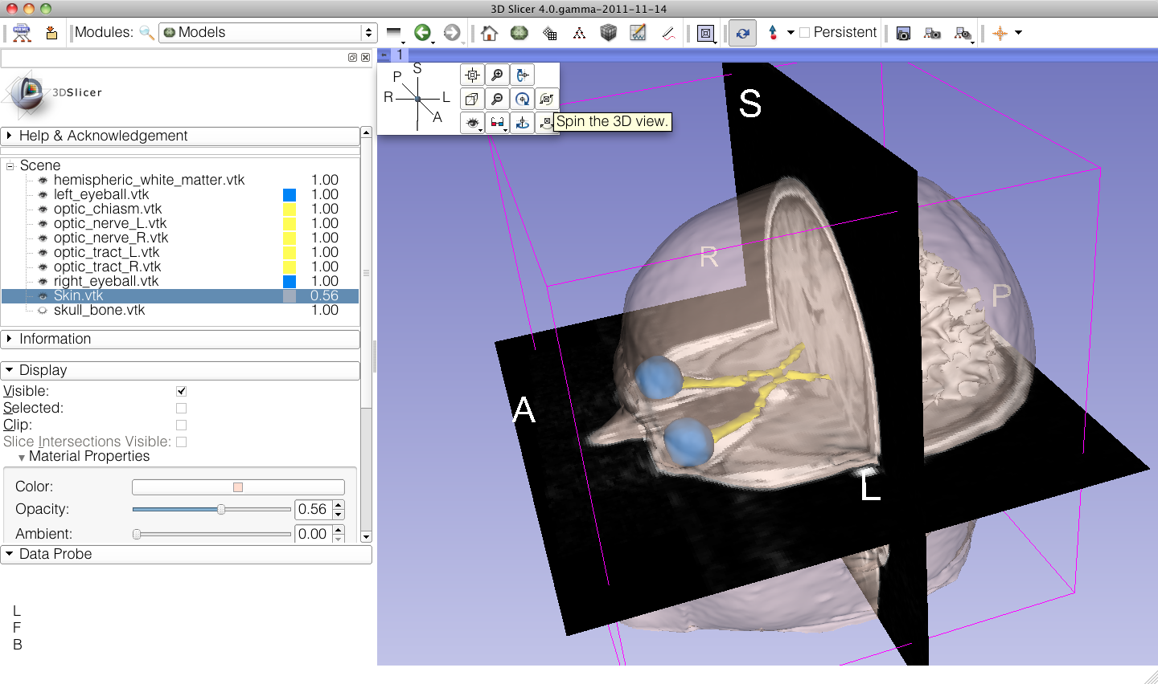
3D Visualization
Click on the Pin icon at the top left corner of the 3D viewer, and click on the Spin icon.

Slide 23
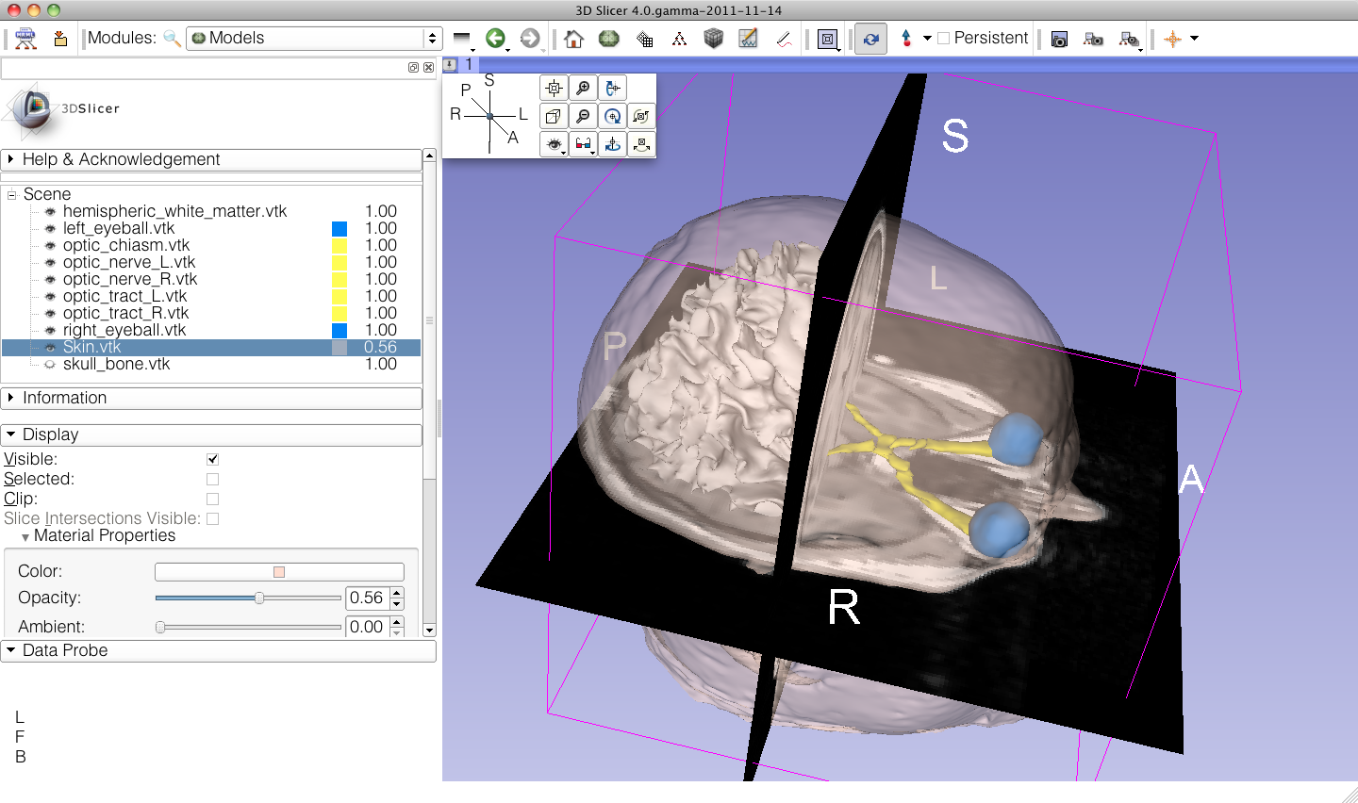
3D Visualization
The 3D models and 2D anatomical slices start spinning in the 3D viewer.
Click a second time on the spin icon to stop the models from spinning.

Slide 24
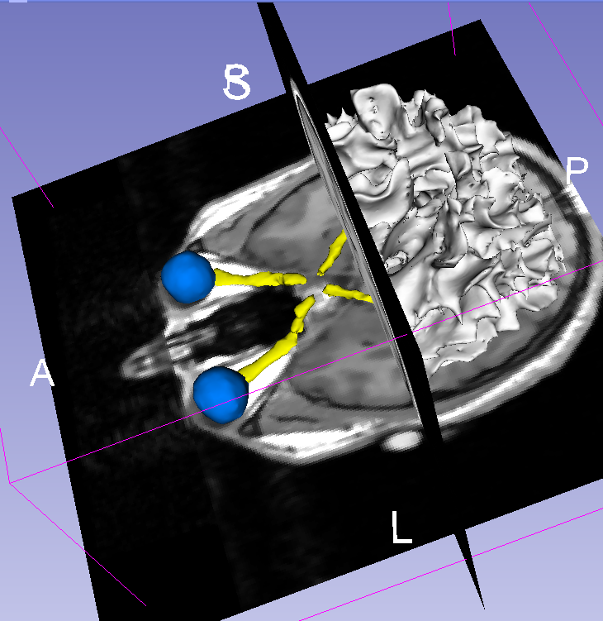
Slicer4 minute tutorial
This tutorial was a short introduction to the 3D visualization capabilities of Slicer.
Visit the Slicer4 training compendium for more information on the software.
http://www.slicer.org/slicerWiki/index.php/Documentation/4.0/Training

Slide 25
Acknowledgments
National Alliance for Medical
Image Computing
NIH U54EB005149
Neuroimage Analysis Center
NIH P41RR013218

