Slide 1
3D Slicer module programming
Beyond the basics

Slide 2
Motivation
Can the module be used from another module (without using GUI)?
If you save and reload the scene, are all the settings on the module user interface preserved?
Most nodes can be transformed. Does your module work correctly if inputs or outputs are transformed?
Does your module work correctly if the scene is closed? If the same scene is loaded twice?
If any of the answers is NO… pay attention!
Notes:
Questions to attendees:
Who has Linux / C++ / python / Slicer / VTK / ITK / Qt experience?

Slide 3
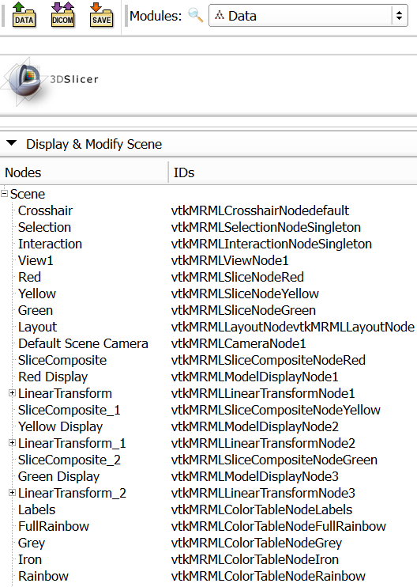
Slicer data model
Global repository for all data: MRML scene (MRML: Medical Reality Markup Language)
List of nodes, each identified by a unique string ID
Relationship between nodes: references, hierarchies
Modules do not need to know about each other!
Notes:
Questions to attendees:
Who has Linux / C++ / python / Slicer / VTK / ITK / Qt experience?

Slide 4
MRML node
Responsibilities:
Store data
Serialization to/from XML element for persistency
No display or processing methods
Basic types:
Data node
Display node: visualization options for data node content; multiple display nodes allowed
Storage node: what format, file name to use for persistent storage of the data node content
Notes:
Questions to attendees:
Who has Linux / C++ / python / Slicer / VTK / ITK / Qt experience?

Slide 5
Node references
Always use this whenever a node relies on data stored in other nodes
Specified by role name, referenced node ID, index (multiple references with the same role is allowed)
Saved/restored with the scene
Not trivial: When importing a scene and a node ID is already found in the current scene, the imported node ID is automatically renamed and all references are updated
Scene
ModelNode1
ModelDisplayNode1
ModelDisplayNode2
ModelStorageNode1
VolumeNode1
VolumeDisplayNode1
VolumeStorageNode1
Notes:
Questions to attendees:
Who has Linux / C++ / python / Slicer / VTK / ITK / Qt experience?

Slide 6
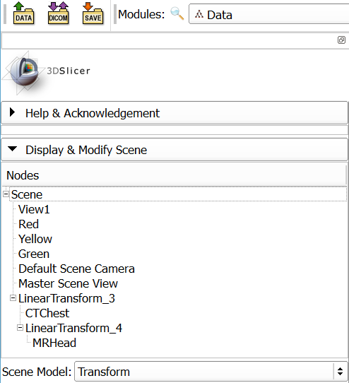
Node hierarchies
Tree structure, for data grouping
Same nodes can be in multiple hierarchies:
Transform
Display
Subject (patient/study/series)
Notes:
Questions to attendees:
Who has Linux / C++ / python / Slicer / VTK / ITK / Qt experience?

Slide 7
Transforms
Slicer world coordinate system: RAS (right-anterior-superior)
Get linear transform from the node to RAS:
nodeToRas = vtk.vtkMatrix4x4()
if node.GetTransformNodeID():
nodeToRasNode = slicer.mrmlScene.GetNodeByID(node.GetTransformNodeID())
nodeToRasNode.GetMatrixTransformToWorld(nodeToRas)
Transform may be non-linear
At least log an error if transform is present but it is ignored
Notes:
Questions to attendees:
Who has Linux / C++ / python / Slicer / VTK / ITK / Qt experience?

Slide 8
Scripted module implementation
Module
(MyFirst)
Widget
(MyFirstWidget)
Logic
(MyFirstLogic)
Notes:
Questions to attendees:
Who has Linux / C++ / python / Slicer / VTK / ITK / Qt experience?

Slide 9
Module class
Required. Only one global instance exists:
module = slicer.modules.volumes
Stores module description, icon, etc.
Creates and holds a reference to logic and widget:
Loadable modules:
widget = module.widgetRepresentation()
logic = module.logic()
Python scripted modules:
widget = module.widgetRepresentation().self()
logic = widget.logic
Notes:
Questions to attendees:
Who has Linux / C++ / python / Slicer / VTK / ITK / Qt experience?

Slide 10
Scripted module implementation
Module
Create
Create
Widget
Logic
Logic
Create (only for scripted)
Current limitation: Scripted module logic is not created automatically, it has to be instantiated in the Widget class.
Notes:
Questions to attendees:
Who has Linux / C++ / python / Slicer / VTK / ITK / Qt experience?

Slide 11
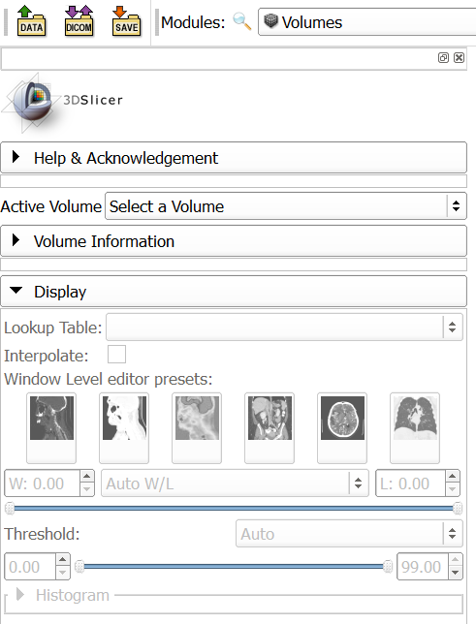
Widget class
Needed if the module has a user interface
Typically only one global instance exists
Defines the module’s user interface
Keeps user interface and nodes in sync (Observes MRML nodes to get change notifications)
Launches processing methods implemented in the logic class
Notes:
Questions to attendees:
Who has Linux / C++ / python / Slicer / VTK / ITK / Qt experience?

Slide 12
Widget class
Include a parameter node selector at the top (or use a singleton parameter node)
If a parameter node is selected then add an observer to its modified events; if modified then call widget’s UpdateGUIFromParameterNode()
If a parameter is changed in the GUI then update the parameter node
Notes:
Questions to attendees:
Who has Linux / C++ / python / Slicer / VTK / ITK / Qt experience?

Slide 13
Scripted module implementation
Module
Create
Create
Widget
Use
Logic
Notify
Observe
Modify
MRML node
Notes:
Questions to attendees:
Who has Linux / C++ / python / Slicer / VTK / ITK / Qt experience?

Slide 14
Logic class
Needed if the module does any processing (always?)
The module must be usable from another module, just by calling logic methods
Must not rely on the Widget class: the module must be usable without even having a widget class
Logic may be instantiated many times (to access utility functions inside)
Logic may observe nodes: only if real-time background processing is needed (e.g., we observe some input nodes and update other nodes if input nodes are changed)
Notes:
Questions to attendees:
Who has Linux / C++ / python / Slicer / VTK / ITK / Qt experience?

Slide 15
Scripted module implementation
Module
Create
Create
Widget
Use
Logic
X
Notify
Notify
Observe
Modify
MRML node
Modify
Notes:
Questions to attendees:
Who has Linux / C++ / python / Slicer / VTK / ITK / Qt experience?

Slide 16
Example
https://www.assembla.com/code/slicerrt/subversion/nodes/1975/trunk/SlicerRt/sandbox/SegmentationUtils/FillRoi/FillRoi.py
Notes:
Questions to attendees:
Who has Linux / C++ / python / Slicer / VTK / ITK / Qt experience?

Slide 17
Common mistakes 1
Module
Create
Create
Widget
Logic
Notify
Observe
Modify
MRML node
Everything is implemented in the widget, therefore the module is not usable from another module or with a custom GUI!
Notes:
Questions to attendees:
Who has Linux / C++ / python / Slicer / VTK / ITK / Qt experience?

Slide 18
Common mistakes 2
Module
Create
Create
Widget
Use
Logic
Problem: changes made to the MRML node are not reflected in the GUI!
Modify
MRML node
Modify
Notes:
Questions to attendees:
Who has Linux / C++ / python / Slicer / VTK / ITK / Qt experience?

Slide 19
Common mistakes 3
Module
Create
Create
Widget
Use
Logic
No parameter node is used. When the scene is saved and reloaded all the settings in the module user interface are lost!
Notes:
Questions to attendees:
Who has Linux / C++ / python / Slicer / VTK / ITK / Qt experience?

Slide 20
Thanks for your attention.

Slide 21
Slicer data model
MRML node
File reader/writer
DICOM importer/exporter
Displayable manager
Editor effect
GUI from UI file: http://www.slicer.org/slicerWiki/index.php/Documentation/Nightly/Developers/Tutorials/PythonAndUIFile
Notes:
Questions to attendees:
Who has Linux / C++ / python / Slicer / VTK / ITK / Qt experience?

Slide 22
Agenda
Observers
GetOutput/Update/GetOutputPort
Memory management
Scripted module
Module template
Debugging (reload&test, PyDev)
Slicelets
Notes:
Questions to attendees:
Who has Linux / C++ / python / Slicer / VTK / ITK / Qt experience?

