Slide 1
CARMA Axial Dilate Filter Tutorial
CARMA Center
The University of Utah

Slide 2
Overview
This module performs a simple 4 pixel radius binary dilation in two dimensions along the axial plane
This filter is used to generate a rough wall segmentation from an endo segmentation in the CARMA segmentation pipeline

Slide 3
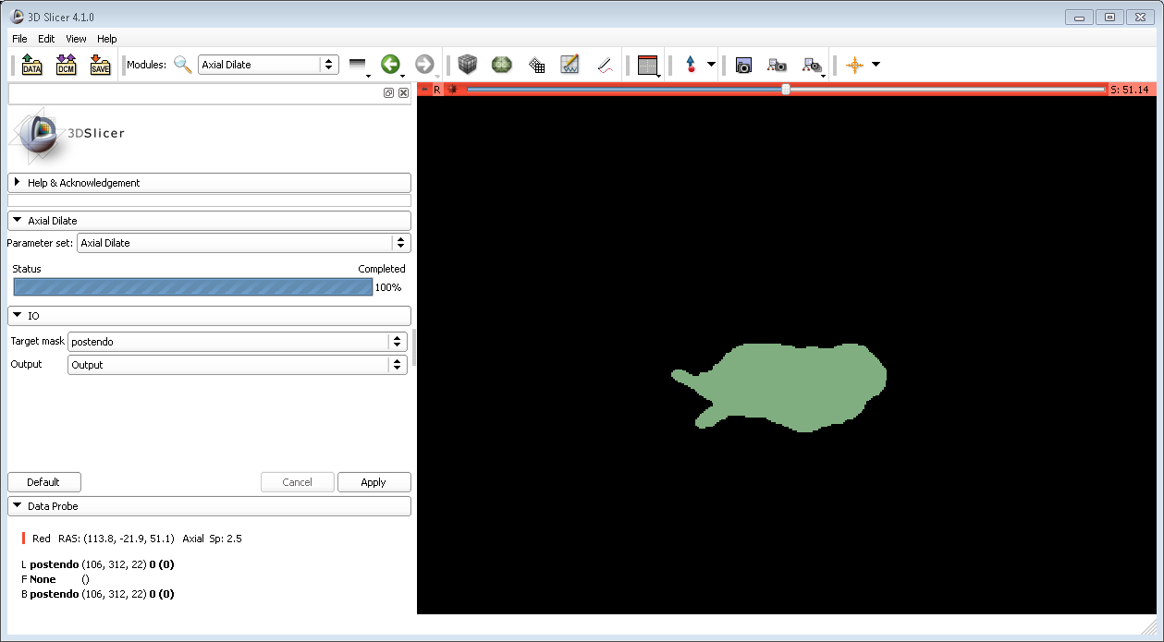
Step 1: Load Image

Slide 4
Step 2: Create Output Image File

Slide 5
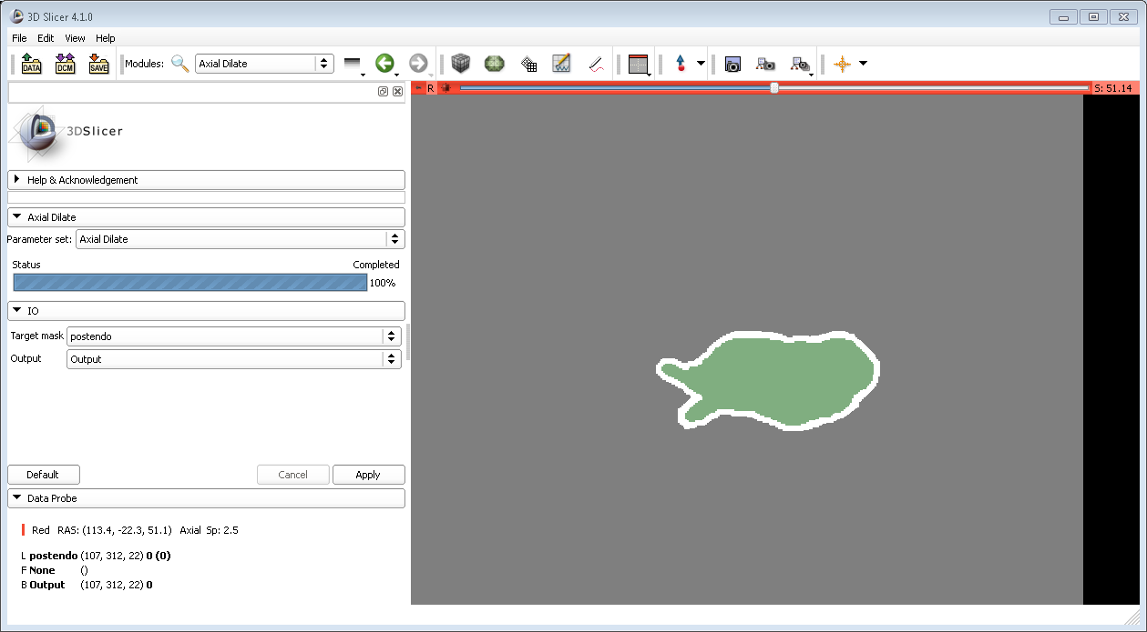
Step 3: Apply Axial Dilate Filter

